Slide 1
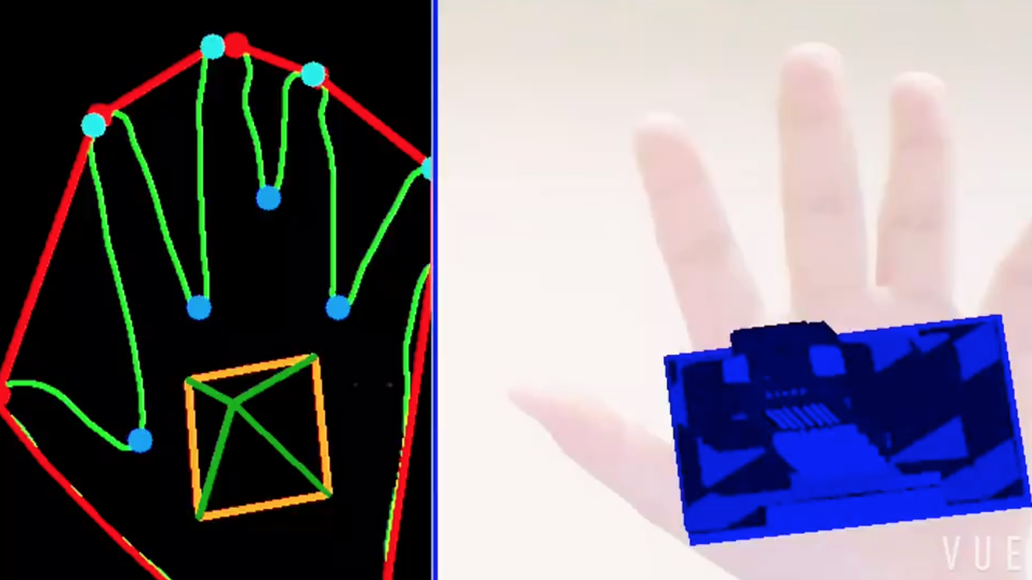
Handy AR: 3D Model
Handy AR using camera calibration and image processing
Group Members
Jiwei Yu Yue Jing Yating Yu Yiran Yan

Slide 2
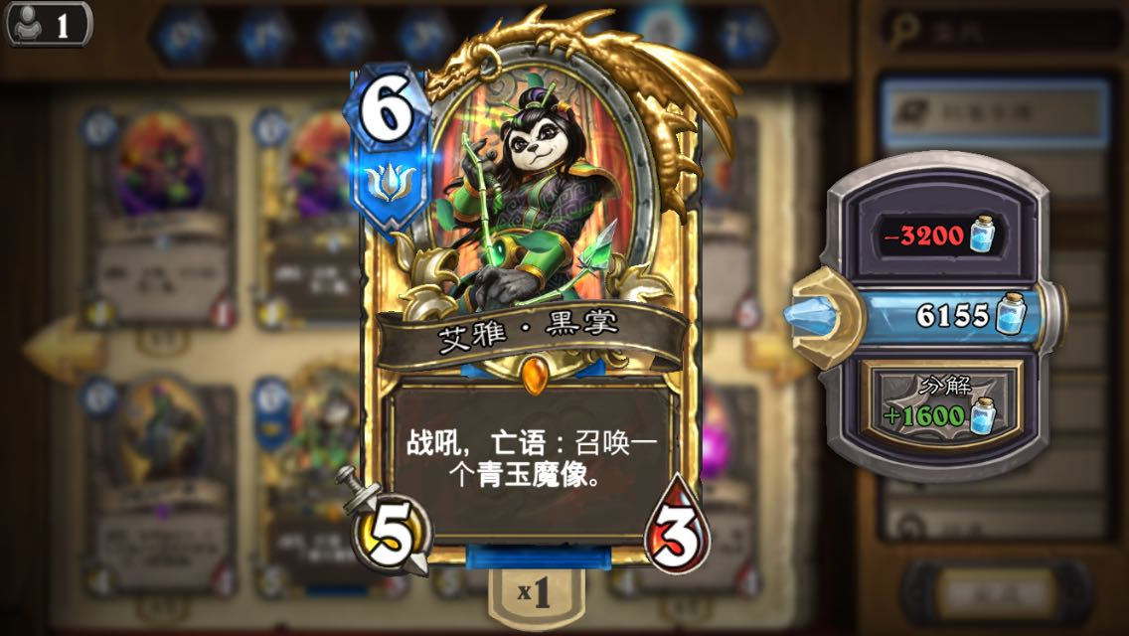
Motivation & Setup
Card Game --
Hearthstone.
OpenCV 2.4
Python 2.7
OpenGL
pygame
PIL
Notes:
Hello

Slide 3
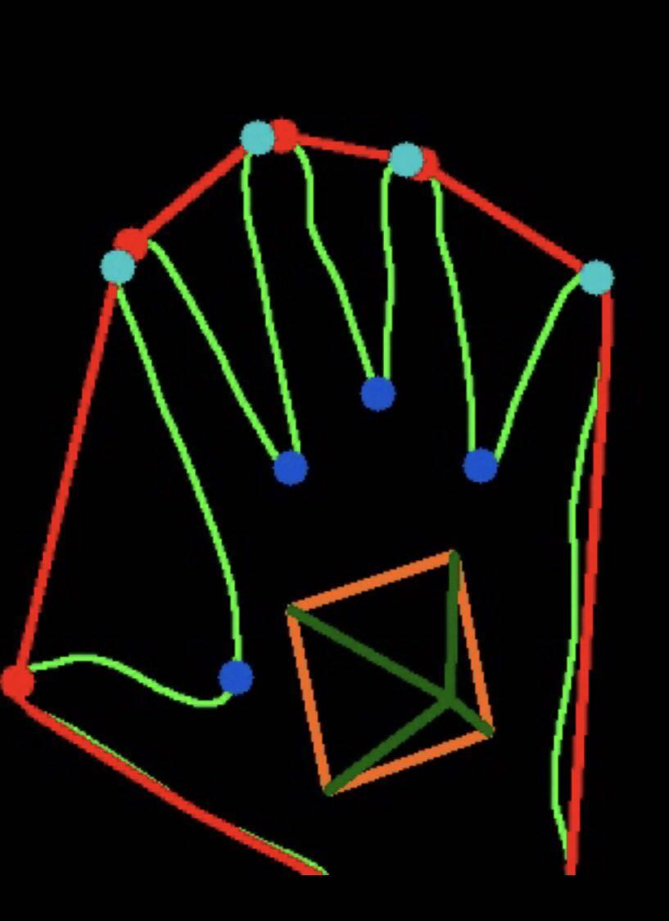
Image Processing
Capture background, then put hand in, remove background and get the shape of hand
Find convex hull of hand contour, then get convex defects(start, end, far points). Compute angles using the theorem of cosine, when angle is less than 90 degree, treat it as fingers
Find 12 image points
Notes:
We remove the background and then detect figures by getting the outline of our figure
cv2.convexHull() function checks a curve for convexity defects and corrects it

Slide 4
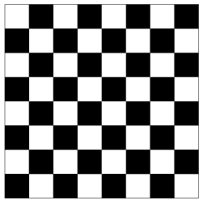
Camera Calibration &
Draw 3D object using OpenGL
Calibrate camera using chessboard, get intrinsic matrix and distortion
Use 12 image points, corresponding hand points, intrinsic matrix, distortion to get extrinsic parameters
Set projection matrix and view matrix in OpenGL using intrinsic and extrinsic parameters.
Draw background and object(objloader).
cv2.findChessboardCorners
cv2.cornerSubPix
cv2.drawChessboardCorners
cv2.calibrateCamera
cv2.solvePnP
Notes:
Use camera to get 30 chessboard images, and get camera intrinsic & extrinsic parameters.
Get image points:
1.Capture background, when putting hand in, remove the background to get shape of the hand(contour)
2. Find convex hall of hand contour, then get convex defects(start, end, far points). Compute angles using the theorem of cosine, when angle is less than 90 degree, treat it as fingers.
3. Get 12 image points through 2.

Slide 5
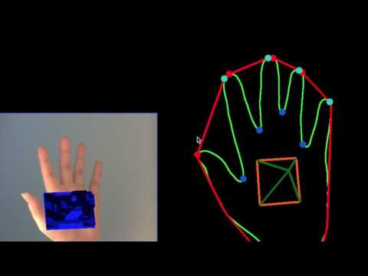
Result and Future Work
Recognize more hand gestures
Develop more 3D objects to satisfy game needs.
https://www.youtube.com/watch?v=RffT-2RdGs0

Slide 6
Thank you !

